Slide 1


Gregory Siegfried
December 21st, 2021

Slide 2

Outline
Executive Summary
Introduction
Methodology:
Insights Drawn from EDA
Launch Sites Proximities Analysis
Build a Dashboard with Plotly Dash
Results
Conclusion
Appendix
<number>
Notes:
<number>

Slide 3
Executive Summary
Summary of methodologies
Summary of all results
2

Slide 4
Introduction
Space X, our biggest competitor, have been able to reuse their Falcon 9 first stage boosters, to allow an entry price of $62 million for orbital launches.
Our company, Space Y, need to figure out launch success and booster reuse-ability, to allow for better analysis in contract bidding.
Our question:
Can we determine the price of a Space X launch based on the success of reusing the first stage?
3

Slide 5

4

Slide 6
Methodology
Data collection methodology:
Describe how data was collected
Perform data wrangling
Describe how data was processed
Perform exploratory data analysis (EDA) using visualization and SQL
Perform interactive visual analytics using Folium and Plotly Dash
Perform predictive analysis using classification models
How to build, tune, evaluate classification models
4
Notes:
<number>

Slide 7
Data Collection
Describe how data sets were collected.
You need to present your data collection process use key phrases and flowcharts
6

Slide 8
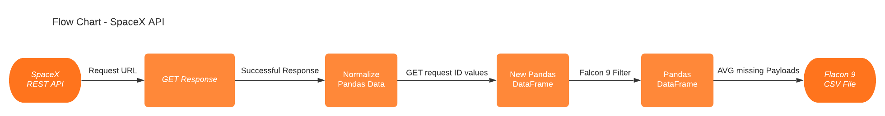
Data Collection – SpaceX API
https://github.com/siegfriedgreg/IBM-Data-Science-Coursera/blob/main/Capstone%20Data_Science/Lab%20-%201%20-%20SpaceX-API%20Calls.ipynb
7

Slide 9
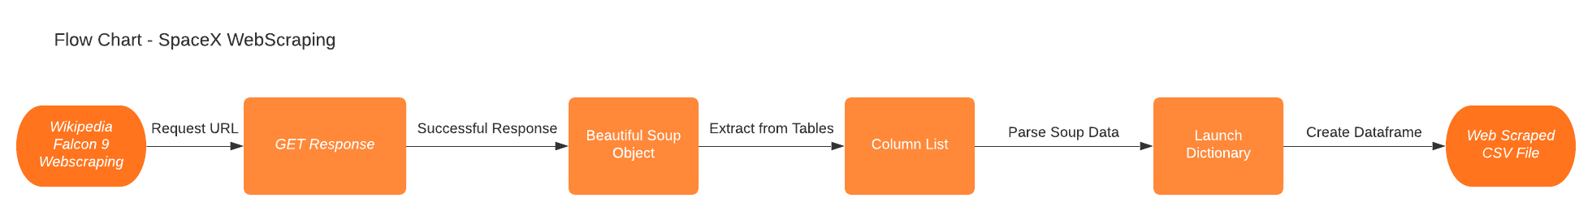
Data Collection - Scraping
https://github.com/siegfriedgreg/IBM-Data-Science-Coursera/blob/main/Capstone%20Data_Science/Lab%20-%202%20-%20SpaceX-Web%20Scraping.ipynb
8

Slide 10
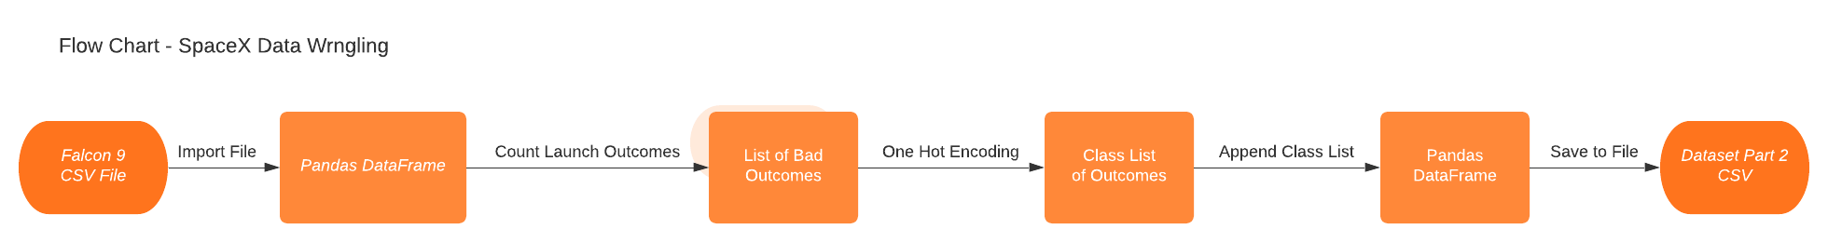
Data Wrangling
https://github.com/siegfriedgreg/IBM-Data-Science-Coursera/blob/main/Capstone%20Data_Science/Lab%20-%203%20-%20SpaceX-Data%20Wrangling.ipynb
9

Slide 11
EDA with Data Visualization
Summarize what charts were plotted and why you used those charts
https://github.com/siegfriedgreg/IBM-Data-Science-Coursera/blob/main/Capstone%20Data_Science/Lab%20-%204%20-%20EDA%20Data%20Visualization.ipynb
10

Slide 12
EDA with Data Visualization
Summarize what charts were plotted and why you used those charts
Add the GitHub URL of your completed EDA with data visualization notebook, as an external reference and peer-review purpose
11

Slide 13
EDA with SQL
Using bullet point format, summarize the SQL queries you performed
https://github.com/siegfriedgreg/IBM-Data-Science-Coursera/blob/main/Capstone%20Data_Science/Lab%20-%205%20-%20EDA%20SQL%20Queries.ipynb
12

Slide 14
Build an Interactive Map with Folium
Summarize what map objects such as markers, circles, lines, etc. you created and added to a folium map
Explain why you added those objects
https://github.com/siegfriedgreg/IBM-Data-Science-Coursera/blob/main/Capstone%20Data_Science/Lab%20-%206%20-%20Folium%20Map.ipynb
13

Slide 15
Build a Dashboard with Plotly Dash
Summarize what plots/graphs and interactions you have added to a dashboard
Explain why you added those plots and interactions
https://github.com/siegfriedgreg/IBM-Data-Science-Coursera/blob/main/Capstone%20Data_Science/Lab%20-%207%20-%20SpaceX%20Dash%20App.py
14

Slide 16
Predictive Analysis (Classification)
Summarize how you built, evaluated, improved, and found the best performing classification model
You need present your model development process using key phrases and flowchart
https://github.com/siegfriedgreg/IBM-Data-Science-Coursera/blob/main/Capstone%20Data_Science/Lab%20-%208%20-%20SpaceX%20Predictive%20Analysis.ipynb
15

Slide 17
Results
Exploratory data analysis results
Interactive analytics demo in screenshots
Predictive analysis results
17
Notes:
<number>

Slide 18


Slide 19
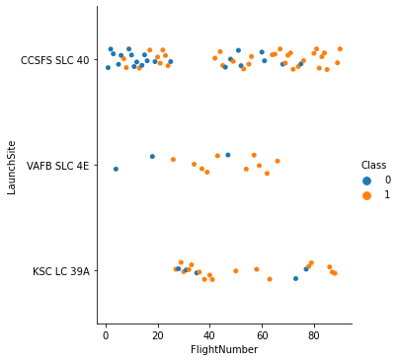
Flight Number vs. Launch Site
Show a scatter plot of Flight Number vs. Launch Site
Show the screenshot of the scatter plot with explanations
17

Slide 20
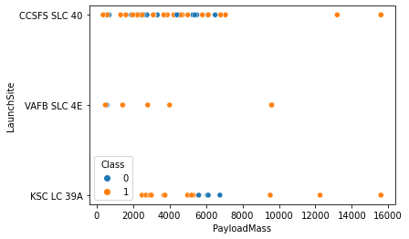
Payload Mass vs. Launch Site
Show a scatter plot of Payload vs. Launch Site
Show the screenshot of the scatter plot with explanations
19

Slide 21
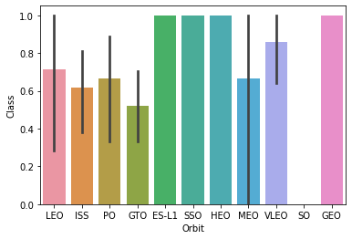
Orbit Type vs. Success Rate
Show a bar chart for the success rate of each orbit type
Show the screenshot of the scatter plot with explanations
20

Slide 22
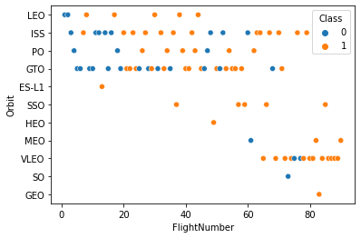
Flight Number vs. Orbit Type
Show a scatter point of Flight number vs. Orbit type
Show the screenshot of the scatter plot with explanations
21

Slide 23
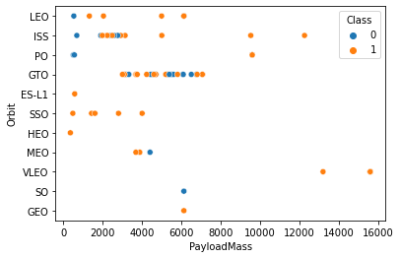
Payload Mass vs. Orbit Type
Show a scatter point of payload vs. orbit type
Show the screenshot of the scatter plot with explanations
22

Slide 24
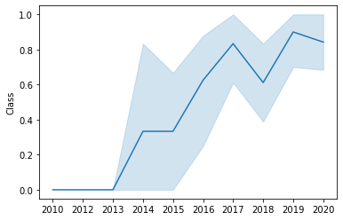
Launch Success Yearly Trend
Show a line chart of yearly average success rate
Show the screenshot of the scatter plot with explanations
23

Slide 25
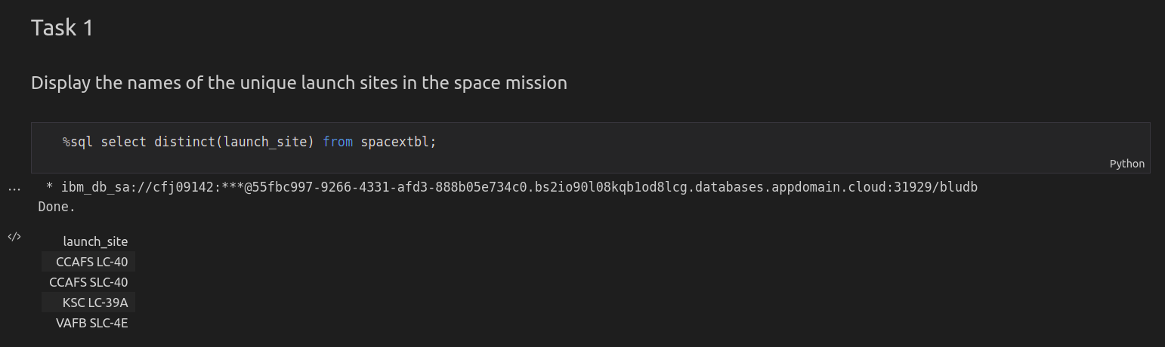
All Launch Site Names
Find the names of the unique launch sites
Present your query result with a short explanation here
24

Slide 26
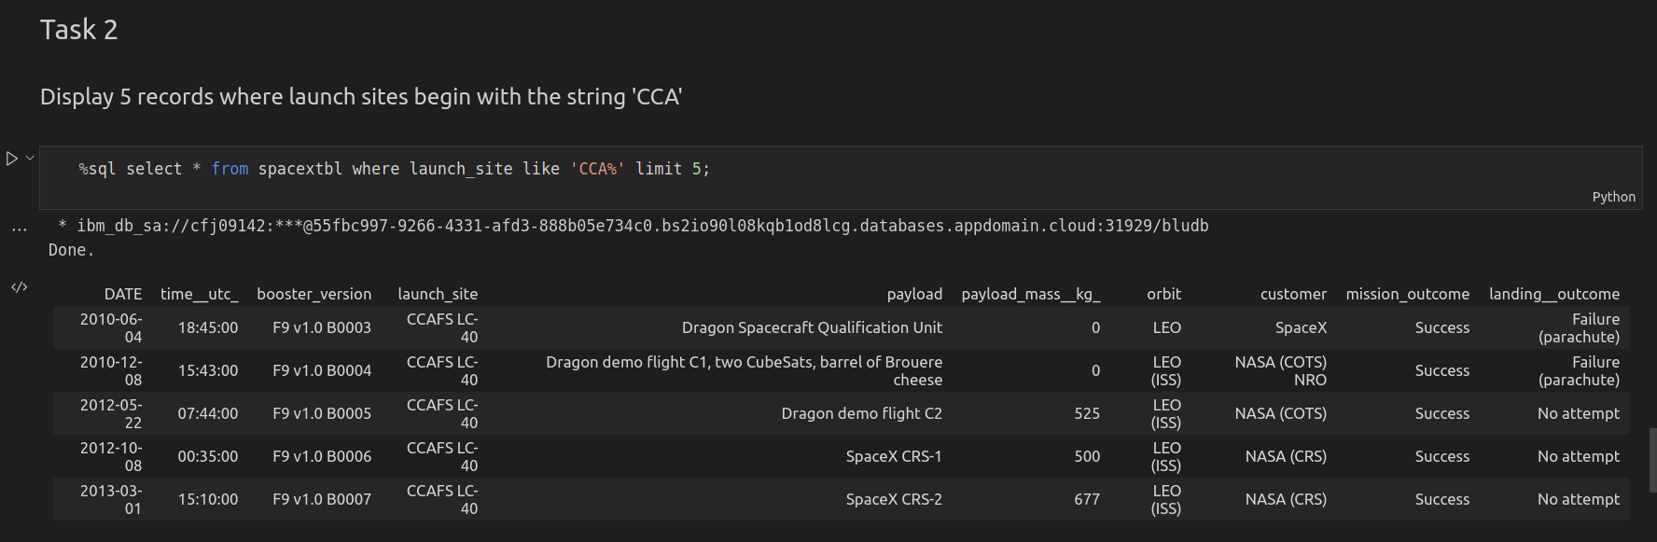
Launch Site Names Begin with 'CCA'
Find 5 records where launch sites begin with `CCA`
Present your query result with a short explanation here
25

Slide 27
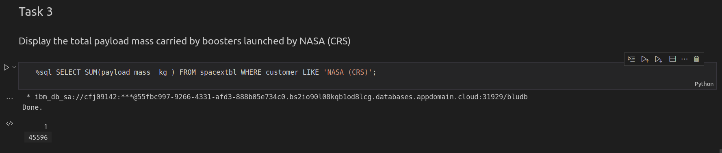
Total Payload Mass
Calculate the total payload carried by boosters from NASA
Present your query result with a short explanation here
26

Slide 28
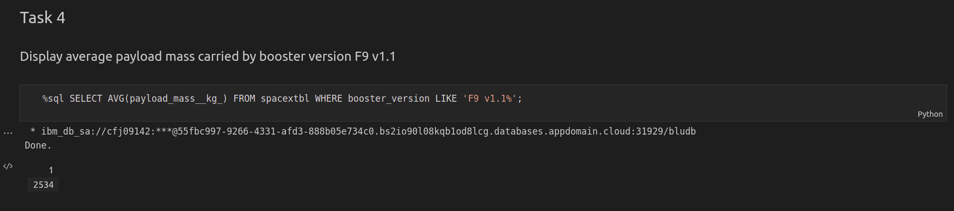
Average Payload Mass by F9 v1.1
Calculate the average payload mass carried by booster version F9 v1.1
Present your query result with a short explanation here
27

Slide 29
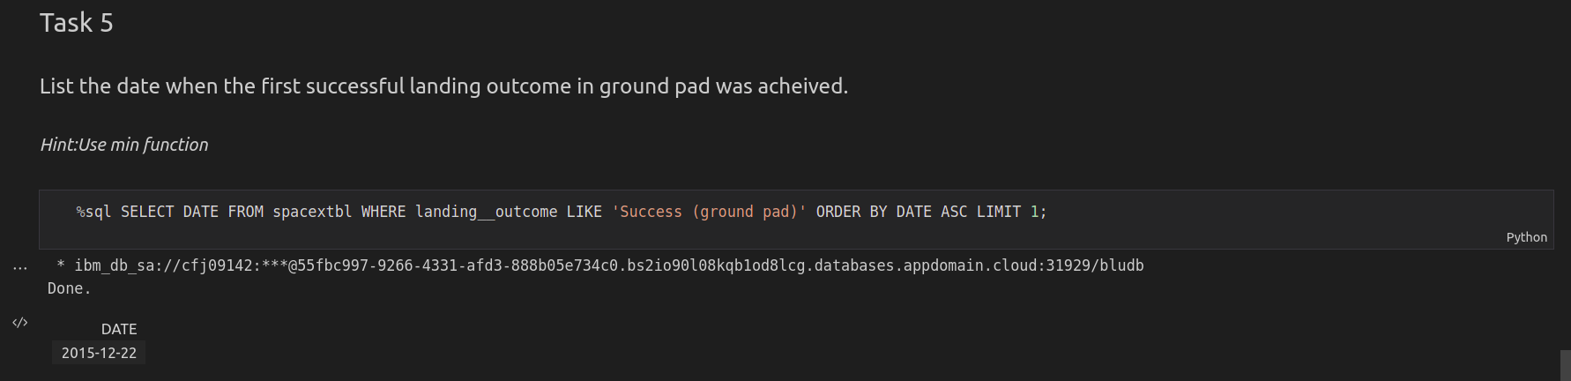
First Successful Ground Landing Date
Find the dates of the first successful landing outcome on ground pad
Present your query result with a short explanation here
28

Slide 30
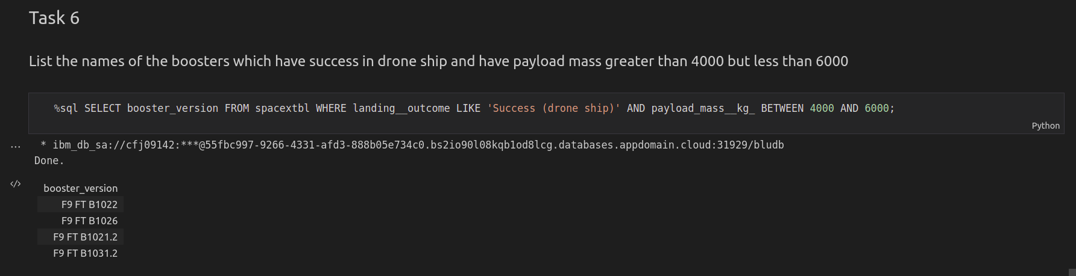
Successful Drone Ship Landing with Payload between 4000 and 6000
List the names of boosters which have successfully landed on drone ship and had payload mass greater than 4000 but less than 6000
Present your query result with a short explanation here
<number>

Slide 31
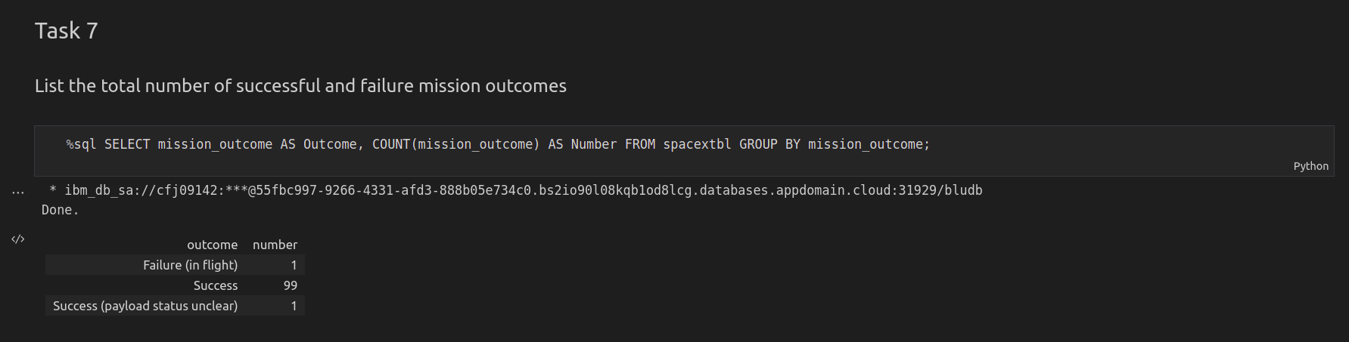
Total Number of Successful and Failure Mission Outcomes
Calculate the total number of successful and failure mission outcomes
Present your query result with a short explanation here
<number>

Slide 32
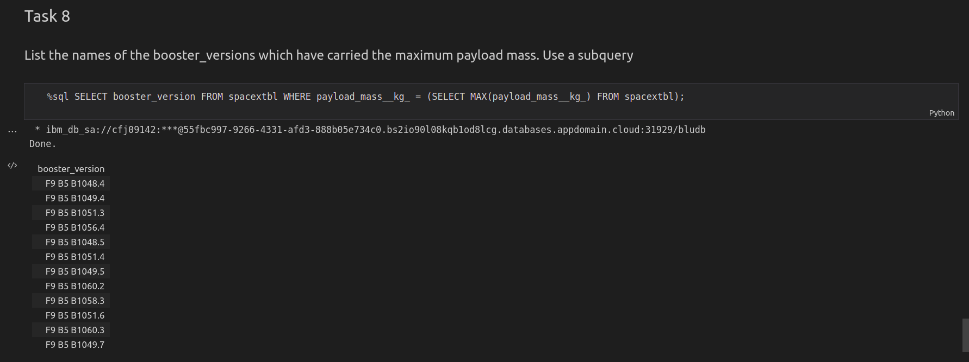
Boosters Carried Maximum Payload
List the names of the booster which have carried the maximum payload mass
Present your query result with a short explanation here
<number>

Slide 33
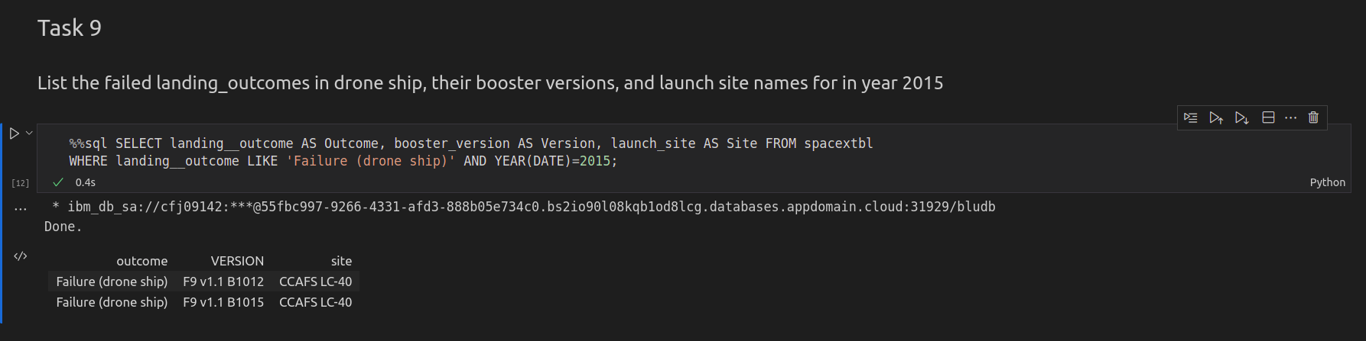
2015 Launch Records
List the failed landing_outcomes in drone ship, their booster versions, and launch site names for in year 2015
Present your query result with a short explanation here
<number>

Slide 34
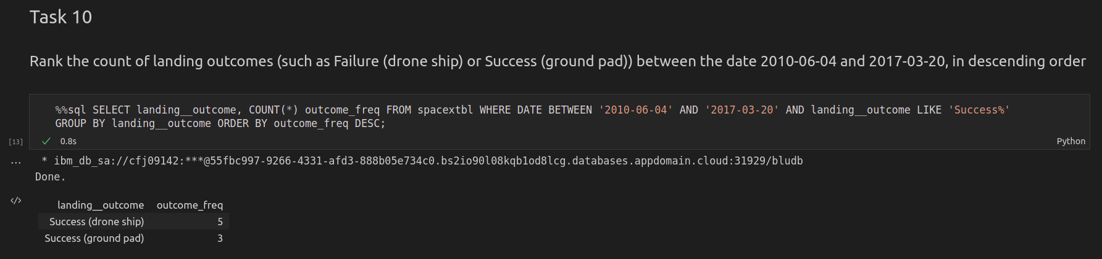
Rank Landing Outcomes Between 2010-06-04 and 2017-03-20
Rank the count of landing outcomes (such as Failure (drone ship) or Success (ground pad)) between the date 2010-06-04 and 2017-03-20, in descending order
Present your query result with a short explanation here
<number>

Slide 35


Slide 36
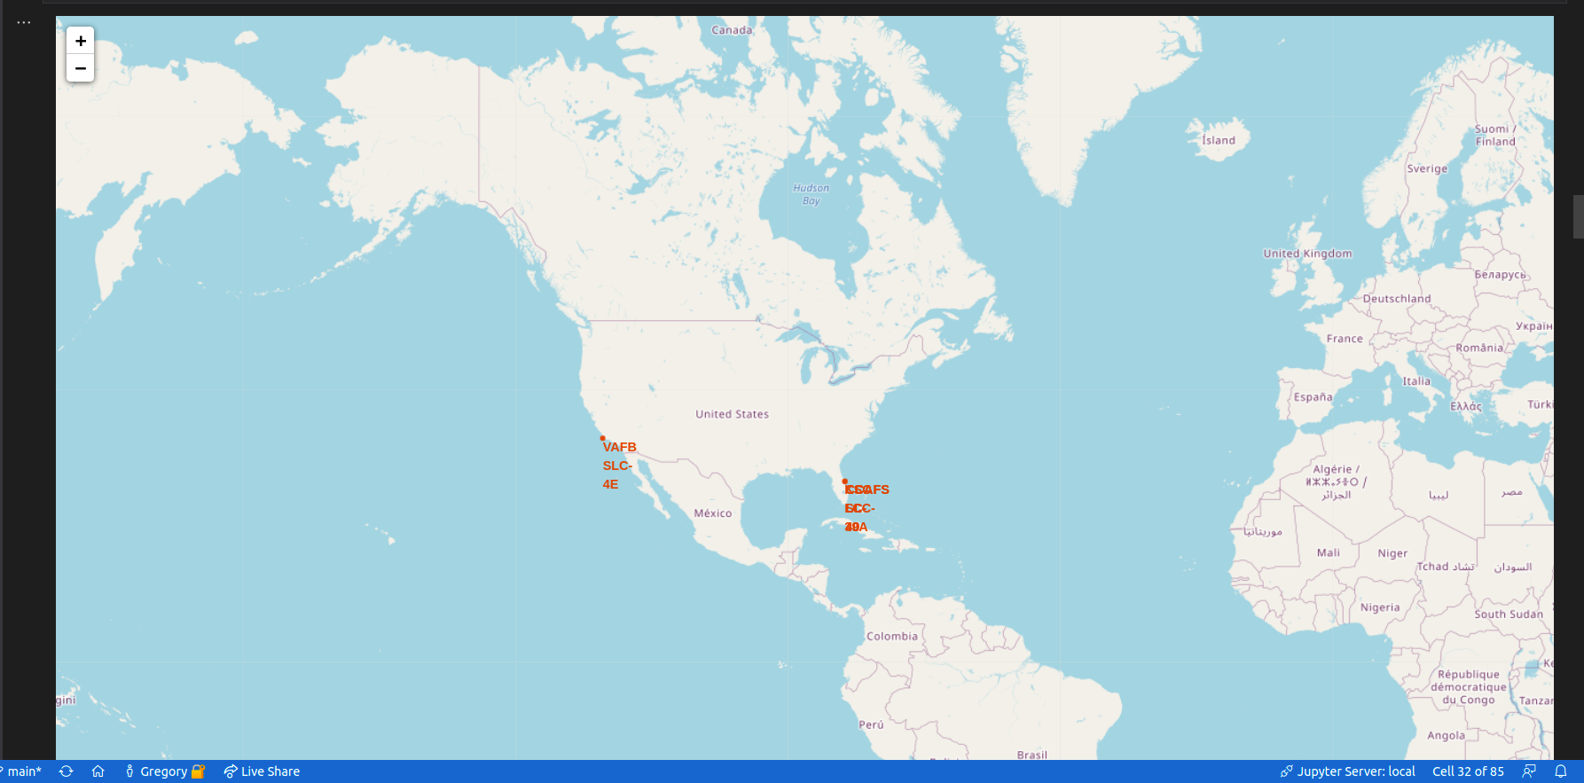
Folium Map - Launch Sites
Replace <Folium map screenshot 1> title with an appropriate title
Explore the generated folium map and make a proper screenshot to include all launch sites’ location markers on a global map
Explain the important elements and findings on the screenshot
<number>

Slide 37
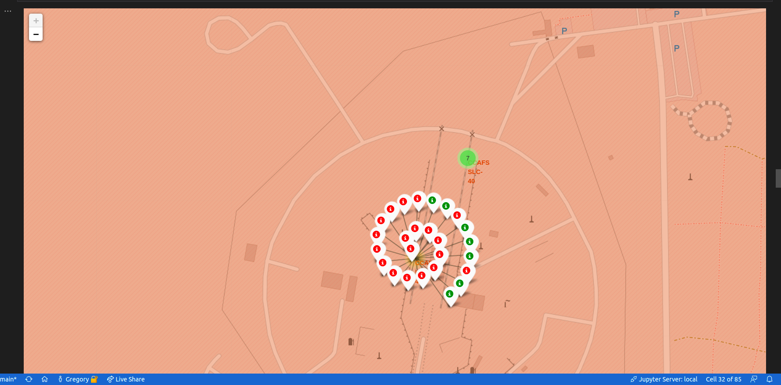
Folium Map – Local Launch Outcome Markers
Replace <Folium map screenshot 2> title with an appropriate title
Explore the folium map and make a proper screenshot to show the color-labeled launch outcomes on the map
Explain the important elements and findings on the screenshot
<number>

Slide 38
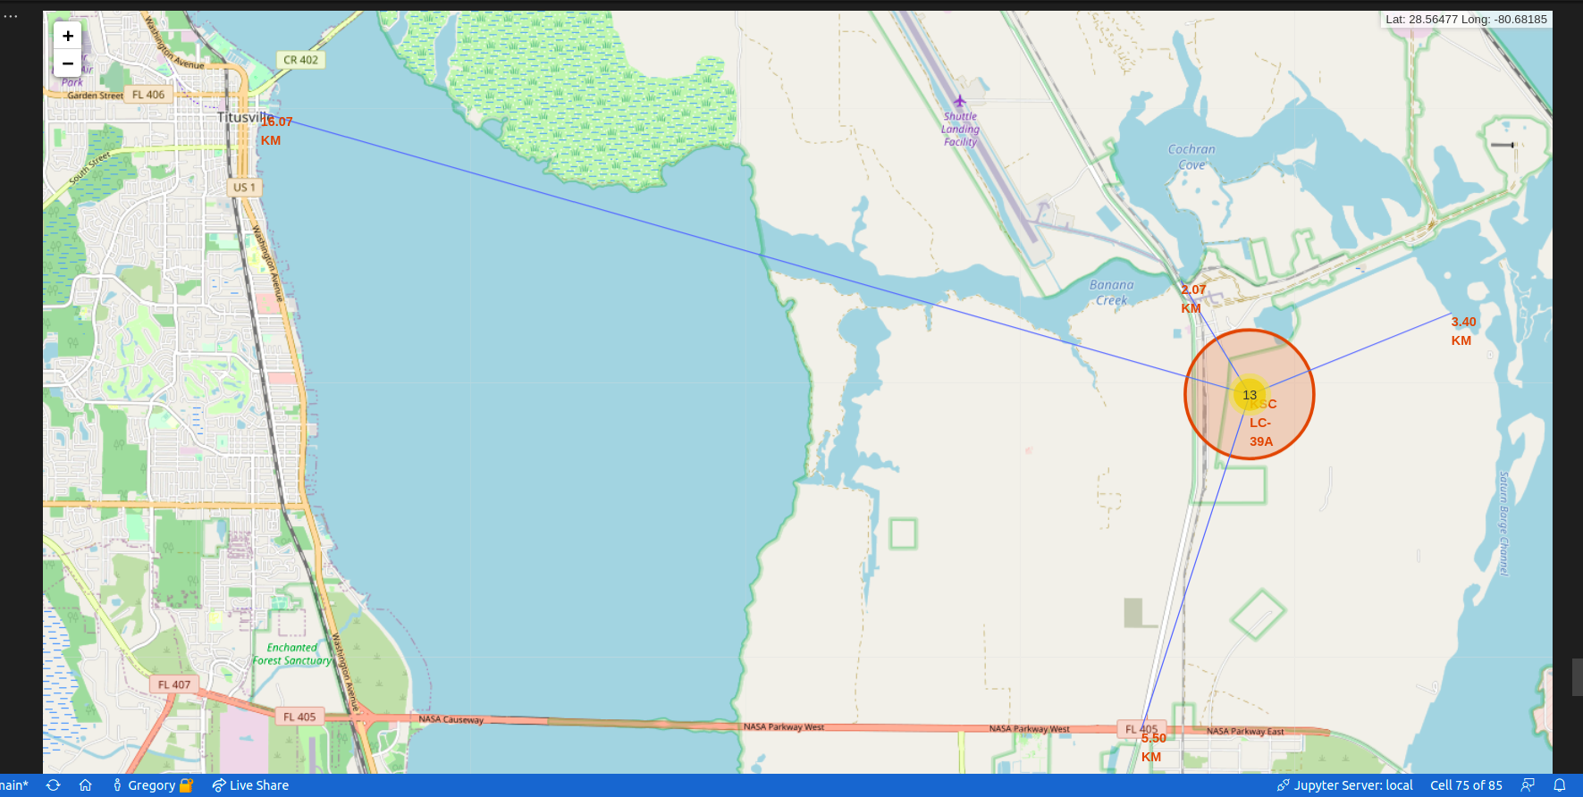
Folium Map – Local Feature Markers
Replace <Folium map screenshot 3> title with an appropriate title
Explore the generated folium map and show the screenshot of a selected launch site to its proximities such as railway, highway, coastline, with distance calculated and displayed
Explain the important elements and findings on the screenshot
<number>

Slide 39


Slide 40
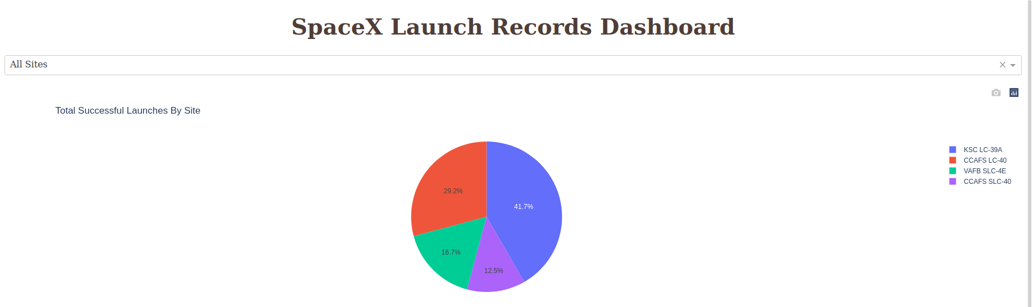
Dash – Successful Outcome by Site
Replace <Dashboard screenshot 1> title with an appropriate title
Show the screenshot of launch success count for all sites, in a piechart
Explain the important elements and findings on the screenshot
<number>

Slide 41
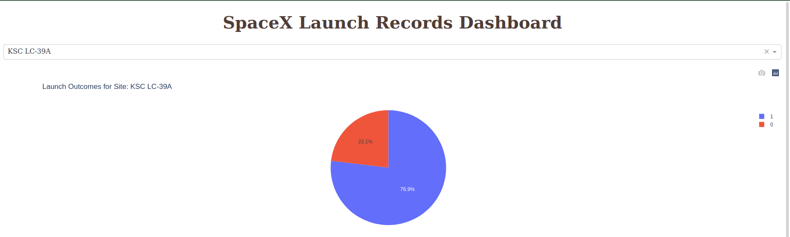
Dash – Most Successful Site
Replace <Dashboard screenshot 2> title with an appropriate title
Show the screenshot of the piechart for the launch site with highest launch success ratio
Explain the important elements and findings on the screenshot
<number>

Slide 42
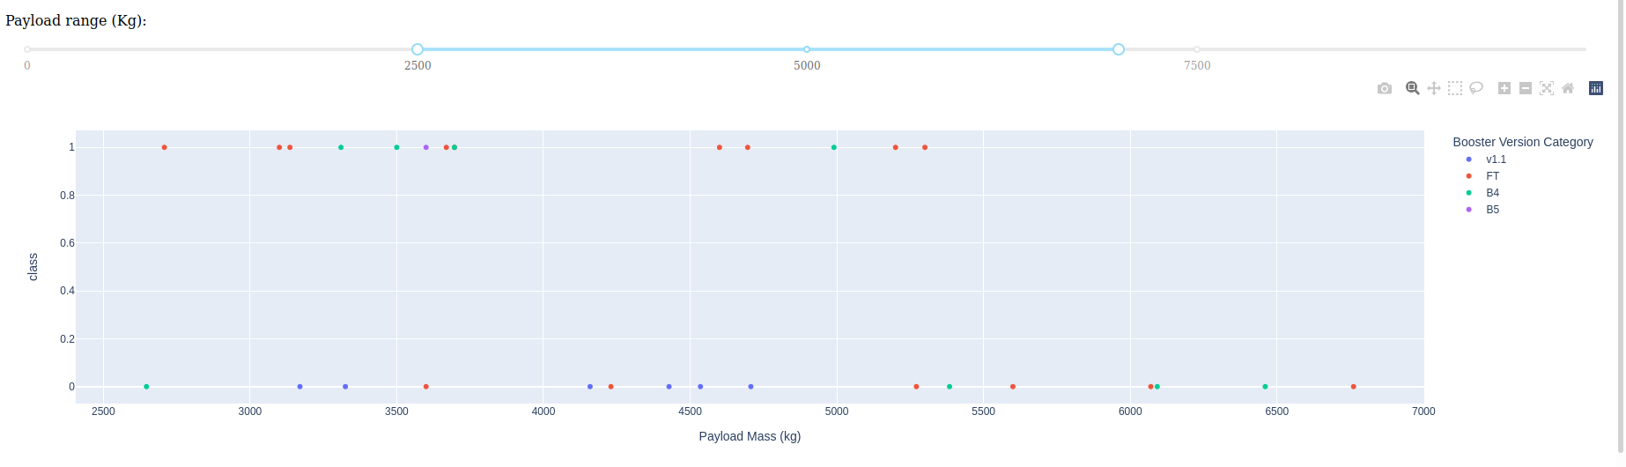
Dash – Payload Mass vs. Launch Outcome
<number>

Slide 43


Slide 44
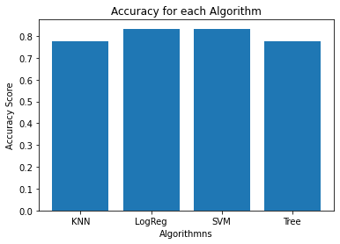
Classification Accuracy
The logistic regression algorithm, or LogReg, performed the best.
<number>

Slide 45
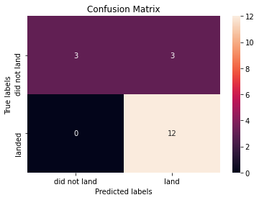
Confusion Matrix
The Logistic Regression Confusion Matrix has 3 false positives where it predicted a flight would land but it did not.
<number>

Slide 46
Conclusions
Point 1
Point 2
Point 3
Point 4
…
<number>

Slide 47
Appendix
Include any relevant assets like Python code snippets, SQL queries, charts, Notebook outputs, or data sets that you may have created during this project
46
Notes:
<number>

Slide 48


